Slide 1
ANDROID WEB VIEW
K.Christy Xavier Raj
130071601021
CSE – 'A'

Slide 2
WEBVIEW:
A “webview” is a browser bundled inside of a mobile application producing what is called a hybrid app. Using a webview allows mobile apps to be built using Web technologies (HTML, JavaScript, CSS, etc.) but still package it as a native app and put it in the app store.

Slide 3
ANDROID WEBVIEW:
Android WebView is a system component for the Android operating system (OS) that allows Android apps to display content from the web directly inside an application. WebView is a view that display web pages inside your application. You can also specify HTML string and can show it inside your application using WebView. WebView makes turns your application to a web application.

Slide 4
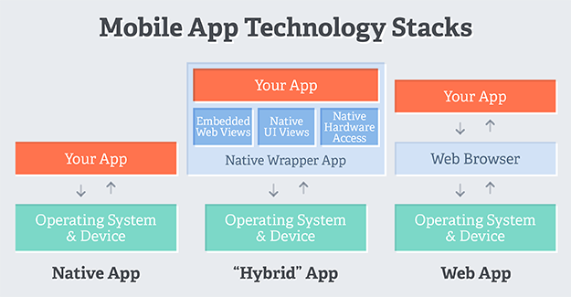

Slide 5
SOFTWARE USED:
ANDROID STUDIO:
Android Studio is the official IDE for Android app development, based on IntelliJ IDEA. On top of powerful code editor and developer tools, Android Studio offers even more features that enhance your productivity when building Android apps, such as: A flexible Gradle-based build system.

Slide 6
TWO TYPES OF SOURCES IN ANDROID WEB VIEW:
REMOTE SOURCE
LOCAL SOURCE
REMOTE SOURCE:
If you're going to load data from a remote URL, your application needs permission to access the internet. This permission needs to be added in the application's manifest file. Remote source is nothing but loading the url in android web view.

Slide 7
LOCAL SOURCE:
A big advantage of using a WebView inside an installable application is that you can store assets inside the app. This lets your app work offline and improves load times, since the WebView can retrieve assets directly from the local file system.
To store files such as HTML, JavaScript, and CSS locally, put them in the assets directory. This is a reserved directory that Android uses for raw files that your app may need access to (i.e. files it knows it should minimise or compress).

Slide 8
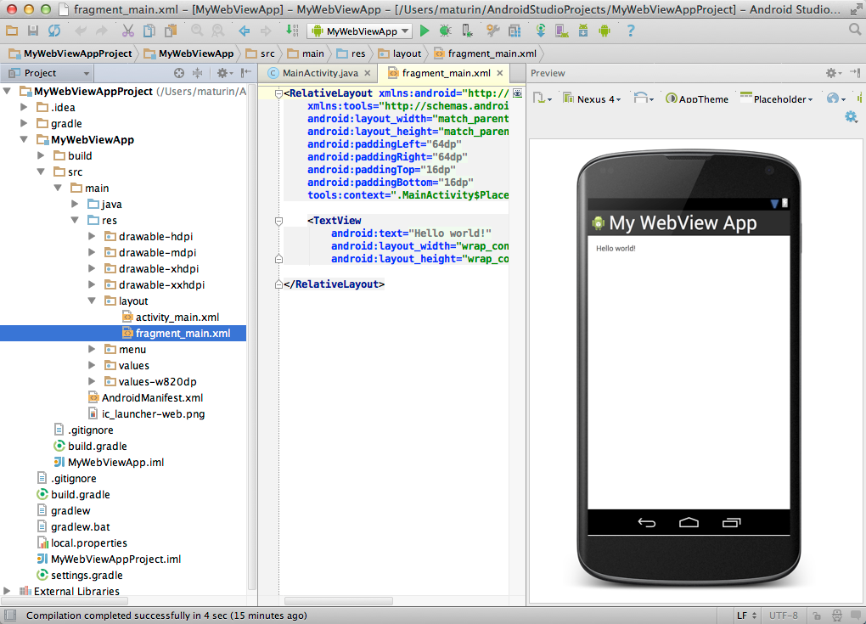

Slide 9
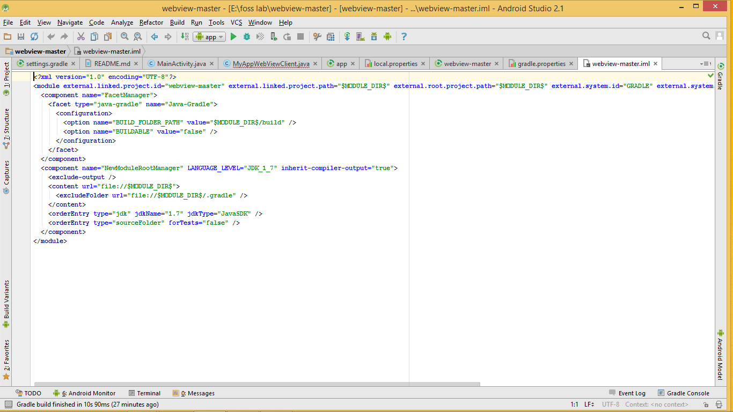

Slide 10
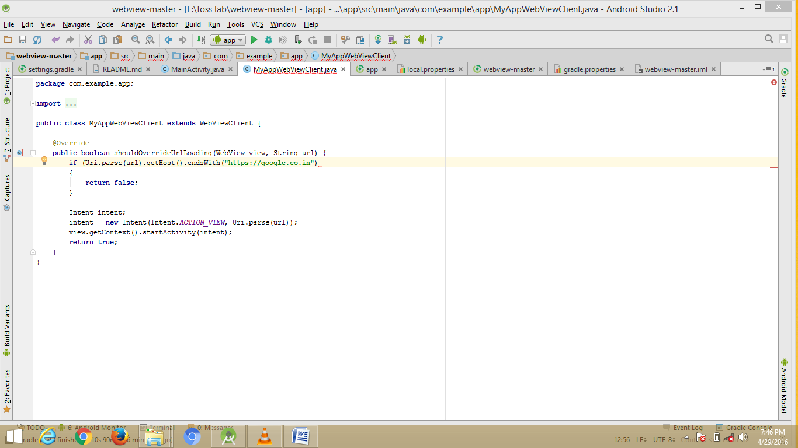

Slide 11
Conclusion:
Thus Webview allows you to view the URL and also your own customized HTML pages which you are created.This can also be converted into an android application

Slide 12
THANK YOU

